Slide 1
Data Visualization and Business Problem Formulation
Consumption Of Energy vs GSDP Region
Mynampati Prudvi
Sohitha M
Ashwin

Slide 2
Introduction
India is the third biggest country in consumption of primary energy like Renewable and non-Renewable resources.
India’s energy demand has been growing rapidly in the last decade. This demand has been boosted by industrial growth as well as a rise in household consumption
The relationship between renewable energy and economic growth across all states in india, which indicates that there is long-run positive causality running from renewable energy to real GDP for the total sample as well as across regions.
The interdependence between renewable energy consumption and economic growth indicates that renewable energy is important for economic growth and likewise economic growth encourages the use of more renewable energy source.
The presence of causality provides an avenue to continue the use of government policies that enhance the development of the renewable energy sector.

Slide 3
Renewable Resources:
Wind Energy : Tamil Nadu is the place we find largest wind power plants.
Hydro Energy : Maharashtra is the place we find generating of hydro power is high
Solar Energy : Gujarat is one of India's most solar-developed states
Biomass and Waste Energy : Maharashtra, Uttar Pradesh and Karnataka each one having more than 1 GW of Grid interacted biomass power

Slide 4
Non-Renewable Energy
Coal : Jharkhand is one of the most coal producer to generate electricity.
Fuel : Assam state has the highest percentage share.

Slide 5
Action
The huge utilization of energy consuming lead to the depletion of the most easily accessible energy resources (i.e., oil, gas, coal)
Renewable energy is generated from solar, wind, wood, waste and biomass. Renewable energy is clean, safe and inexhaustible. Therefore, it is growing fast around the world and according to expectations it will edge out many conventional energy components and occupies a leading position in the overall share of energy consumption
As most states of Western Region are utilizing more power than any other region but southern region states consumption of power from last 2-3 years is increasing rapidly and they are also in deficits and demand in need of power . Now ,they have many opportunities to get rid from this problem by installing renewable energy resources like Wind , Solar,Biomass and Waste

Slide 6
Deliverables

Slide 7
Most Affected Deficit Regions:
Southern and northern region states have more deficit in production and to reach the demand of utilization but these two regions :
Northern Region : In this region the temperature of climate is very low and most of the time their we can see snowfall in most of the states they use more electric city for heater and production is very less as we cannot install non renewable energy generators also.
Southern Region : The climate conditions are moderate in this region but there is a huge development in software industries, hardware industries and huge populations are staying in this region for employment they require more power for continuous functionality of industries and house holders as they don’t have sufficient power in their for full fill this demand they buy power from other states which generates more than what they require.

Slide 8
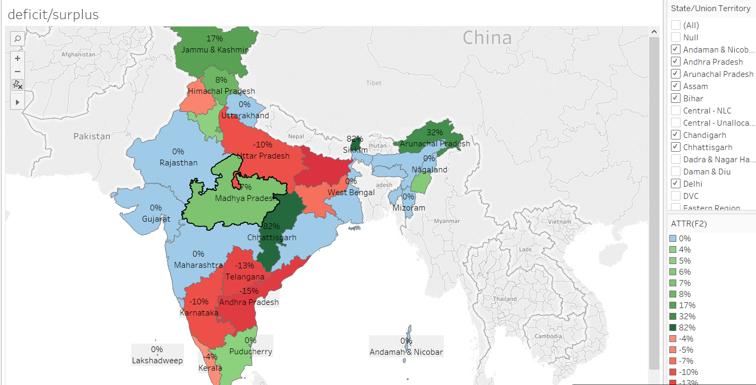
Highest
Surplus : Madhya Pradesh
Deficit : Andhra Pradesh
Brightness of states increase as the deficit/surplus increases

Slide 9
Renewable and Non-Renewable Energy
The Energy consumption increases with the increasing number of developing areas population. In order for this development to continue, while maintaining quality of life, new and renewable energy sources must be found and utilized.
Nonrenewable energy makes up 85% the energy used on earth—the most popular form of energy being coal in india. Over the year India is one of the countries with the largest production of energy from renewable sources.
Over the period production of energy out of non renewable resources is decreased while the renewable energy became primary source.

Slide 10
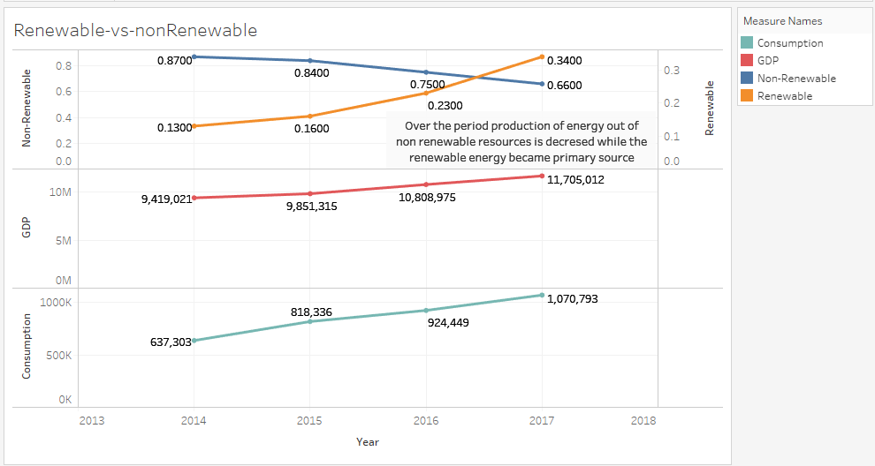

Slide 11
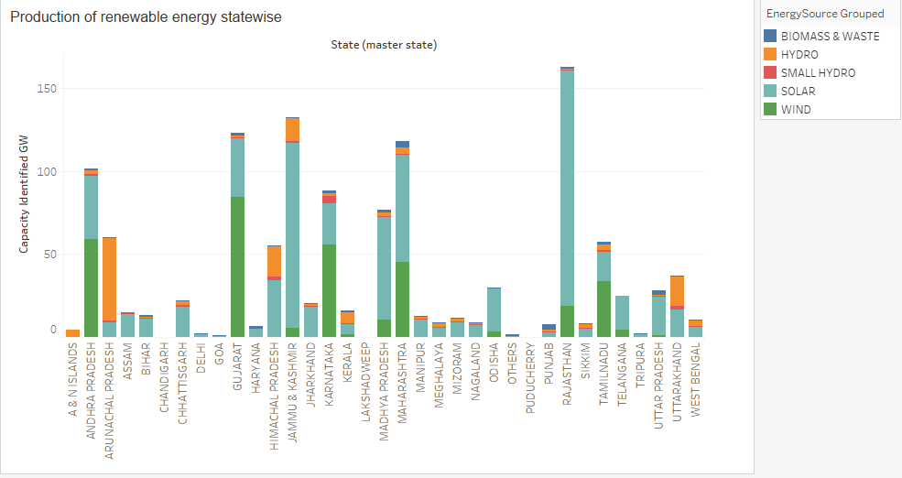

Slide 12
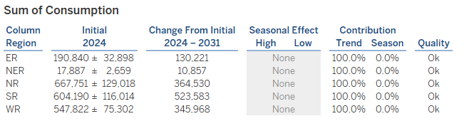
Forecasting the Consumption of energy for Future
Estimating the consumption of energy by regions with respective of population for the next 5 years to know the status of their production to increase to reach the mark without deficit.
Northern Region is Going to consume more energy than any other region.
Estimating the Results .

Slide 13
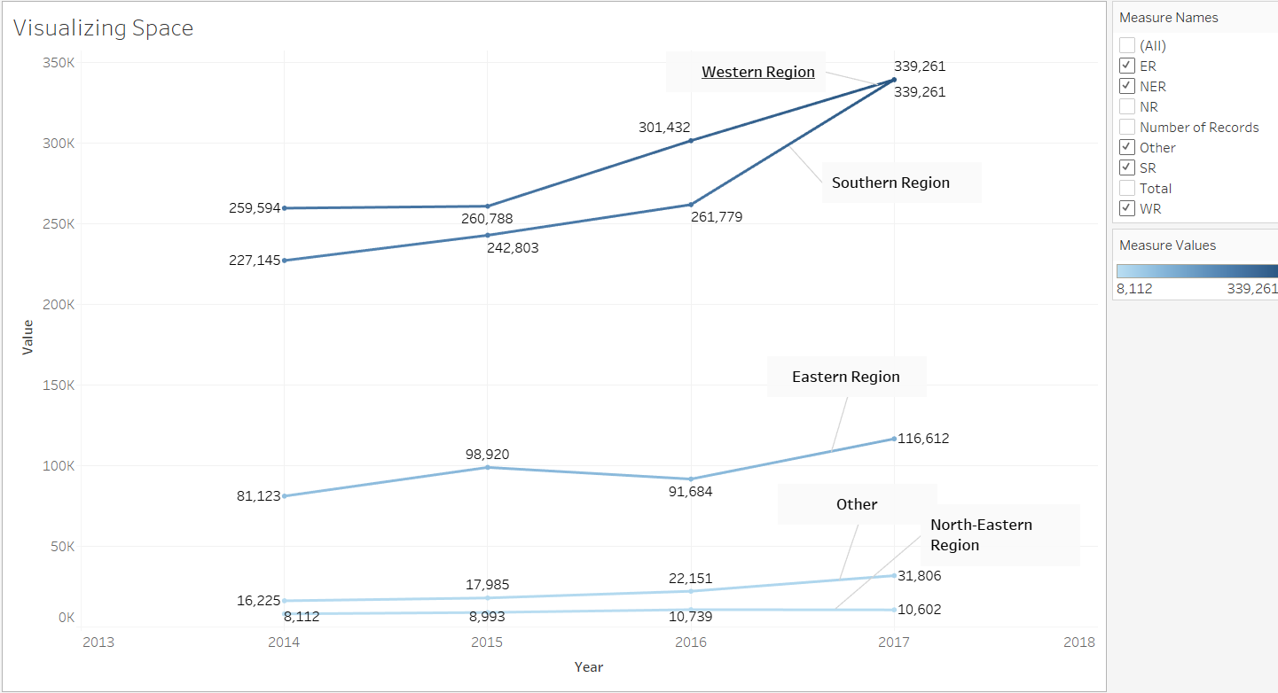
Consumption of energy Region wise from 2014- 2017
As per the data records of 4 years from 2014-2017 the utilization of energy in southern and Western region is increasing rapidly year by year .
By considering this data from 2016-2017 the southern region utilized 2 times whatever the electricity used by Western region.
Remaining 3 regions are varying approximately 10% from what they are utilizing every year

Slide 14
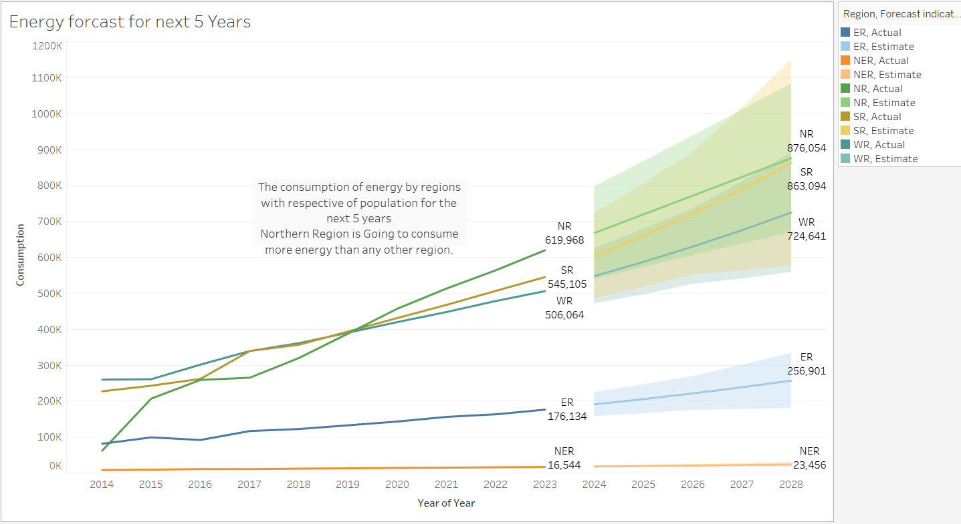

Slide 15
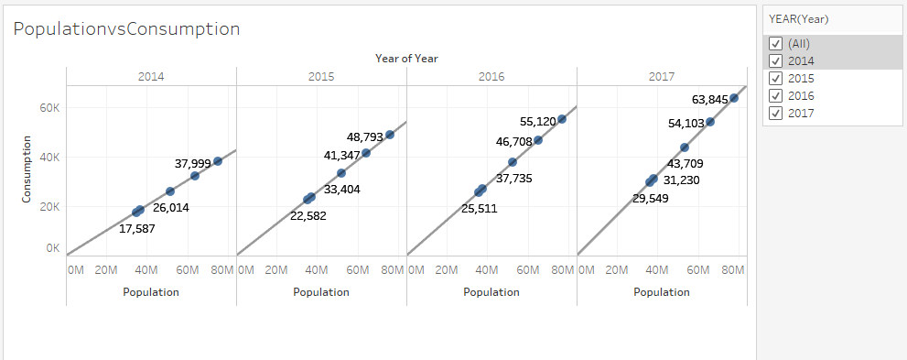
As the population growth rate increases by 1.3% every year make difference in consumption of the energy requirement for the daily usage and industrial usage more and more as the population increases.

Slide 16
Urban and Rural Population Consumption and GDP
The total indian population is divided into two categories Urban and Rural Populations.
The most of the population stays in rural areas than urban areas where the cost of living is higher .so ,the rural areas peoples consume more electrical energy and the space area is also high in rural region .
Where we have more consumption there we have more GDP rate of Growth..

Slide 17
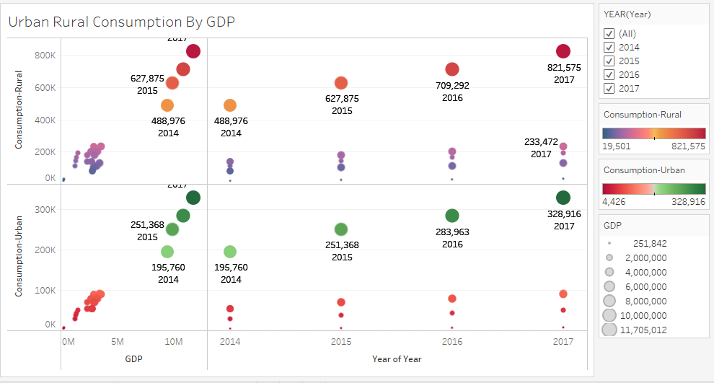

Slide 18
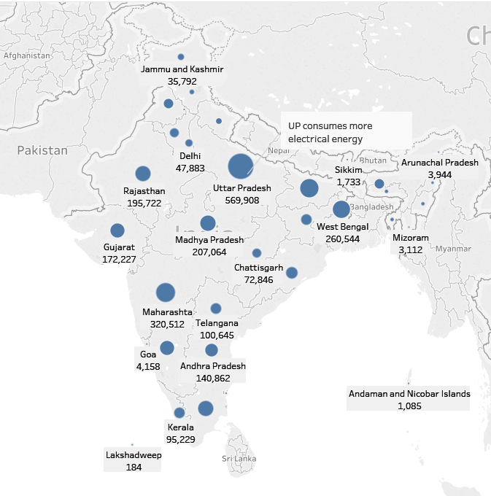
Total Consumption of Energy State Wise
UP was among high energy-consuming states. Demand (year-on-year) increased by around 12% in Maharashtra, 20% in Uttar Pradesh, 12% in Andhra Pradesh, 14% in Telangana

Slide 19
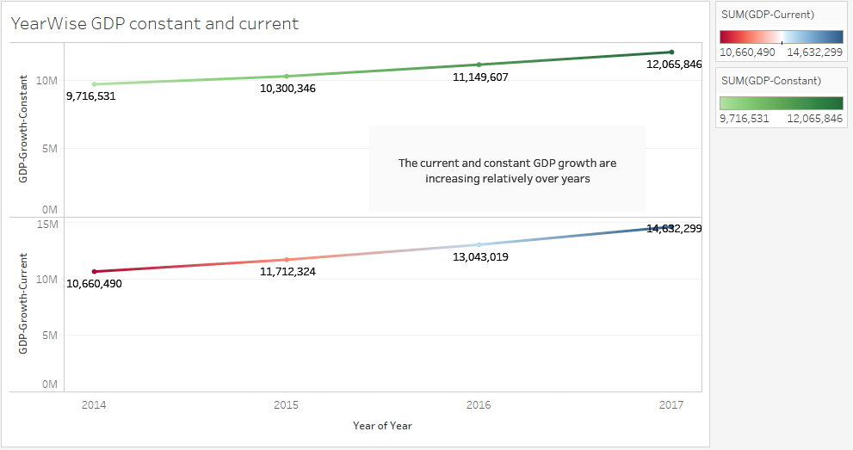
GDP constant and GDP current growth over a period of 2014-2017

Slide 20
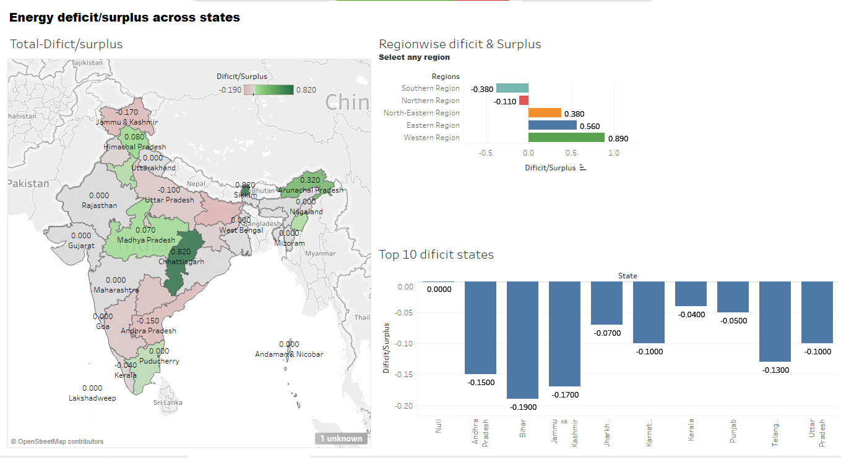
Dashboard for Energy Surplus/Deficit

Slide 21
Assumptions:
Population increment has been assumed by 1.3%YoY
Most of the industrial investors are attracting to invest in renewable resource to make high profits
Calculated consumptions using formulas extracted from Trend line
Avg power consumptions per year

Slide 22
Extra Credit:
Calculate the consumed resource of last 5 Years from the recorded data and predict the use of next coming years and be prepared for that to supply power without any interruption.
Installed power grid maintenance strategies and their utilizations.
Northern Region is utilizing more energy than any other region from last few years shown in the below Visualization.
Maharashtra state is standing high in the GDP from 2011-2018.

Slide 23
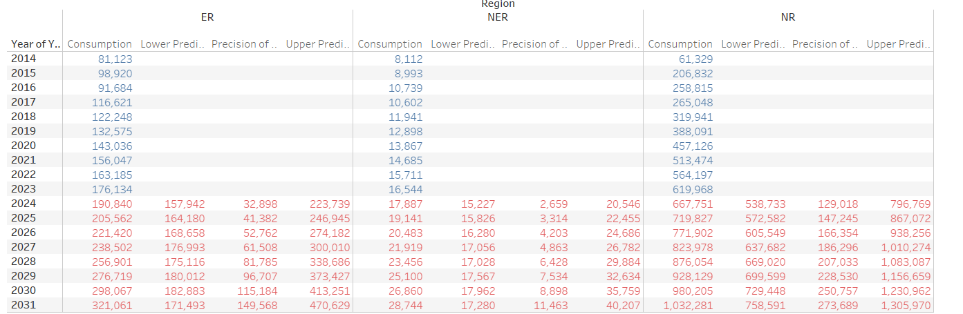
Energy Consumption Region Wise Forcast

Slide 24
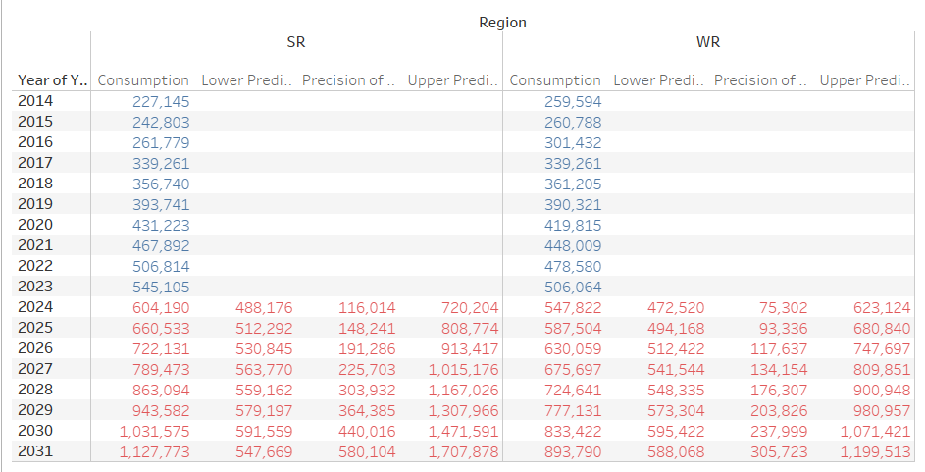

Slide 25
Energy Consumption by State Methodology:
Consumption of energy by Region over all year utilization from 2014 to 2017
Aggregate to consumption region Level.
Deficit and surplus according to state level
Current GDP Methodology:
State wise growth according to the respective years from 2011-2018.
Fluctuation of growth rates year by year approx 3%.
State wise GSDP in crores increases as years increases.

Slide 26
Data Preparation for Data Visualization
Population Growth Rate :
Population(2012)=Population(2011)+Population(2011)*0.013
Consumption Calculation according to population region wise Formula:
ER=0.00268109*Population+-672123
NER=0.00147977*population+-61637.6
NR=0.0130961*population+-4.92231e+06
SR=0.0102988*population+-2.48947e+06
WR=0.00751263*population+-1.87849e+06
Consumption of energy by single person in india from 2014-2017
Energy(Ghw) Year
0.000506723 2014
0.000642313 2015
0.000716289 2016
0.000819033 2017

Slide 27
Recommendations
Tamilnadu is right place to invest generating wind power
Maharashtra is a place where we find huge storage of water which will help to generate hydro power
Gujarat state is dry and hot weather most of the days where solar energy is the right choice for industrialists
Maharashtra, Karnataka and UP have great plans for agro residues, forest and wastelands to generate Bio Mass energy

Slide 28


